Slide 1
Technical Writing
Unit One
Revision

Slide 2

The Stranger in the Town
Bivek Ghimire
Kalanki-14, Kathmandu
E-mail Address: bibekghimire515@gmail.com
Contact No: 9841983017
Working Experience:
Institution: Caspian/Caribbean College, Kumaripati
Designation: +2 English Teacher
Duration: Current
Institution: Ed-Mark College, Kalanki
Designation: Lecturer of Business English
Duration: 2 Years

Slide 3
Cont.
Institution: Ideal Model Secondary School, Dhobighat
Designation: Secondary English Teacher
Duration: Current (for 7 years)
Institution: Reed Model School, Thulobharyang
Designation: Secondary English Teacher
Duration: 3 years
Qualification
M. Phil: IACER (Pokhara University) Baneshwor, Kathmandu
Masters: Patan Multiple Campus, Patan Dhoka, Lalitpur
Bachelors: Janamaitri Campus, Kuleshwor, Kathmandu
Intermediate: Capitol Hill College, Teku, Kathmandu
S.L.C: Shramjit Kishor Secondary School, Lukhunsi, Lalitpur

Slide 4

Let’s Get Going Then….
A story to commence with

Slide 5

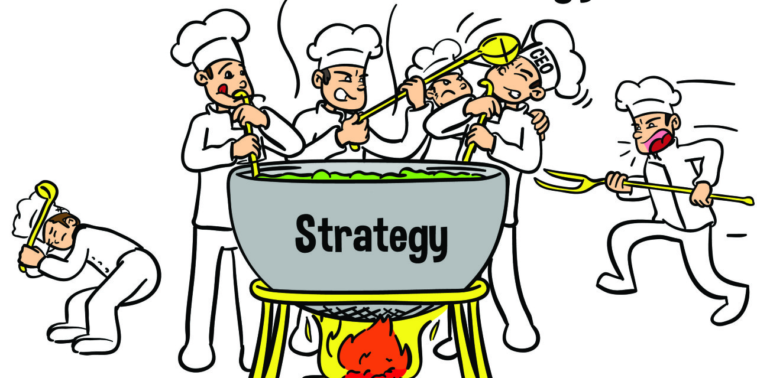
OOPS!

Slide 6


Theme?

Slide 7

Back to the Topic
What is Writing?
It is a skill
It is communicating
It a medium of human communication
The process of applying symbols or codes (letters of the alphabet, numbers) to exchange thoughts and ideas in a readable form

Slide 8
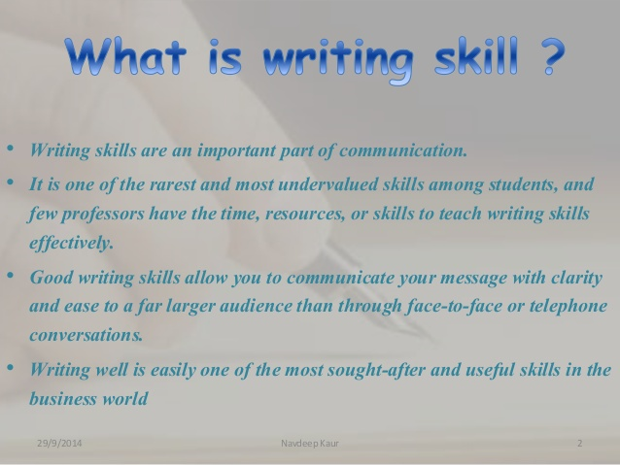
Writing in a nutshell

Slide 9
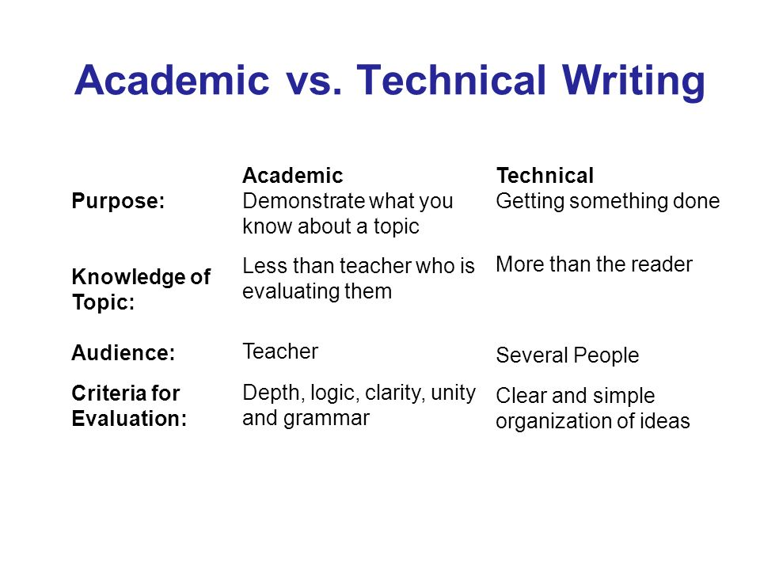
What is Technical Writing?
An art of sharing information in a scientific or occupational workplaces
Reader or audience-centred
Writing in technical fields
Used every day by professionals and
consumers to solve real problems.
Research-based writing
Useful to communicate technical information

Slide 10

Features of Good Technical Writing
Well-versed communication skills Fluent with digital tools (created with graphics, images and screen captures, elaborated with the aid of in charts and tables)
Accessible, clear, and easily understood
Purposeful
Contextual
Well-structured
Detailed
Focused
Problem Solving

Slide 11
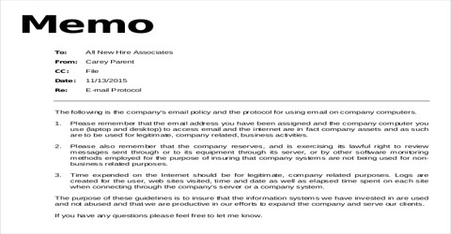
Examples of Technical Writing
Most of the forms of Business Writing (writing used in professional contexts)
E-mails
Technical Reports
Memos (memoranda)
Proposals
Executive Summaries
Press Releases
Newspaper Articles
User Interface Texts
Websites

Slide 12
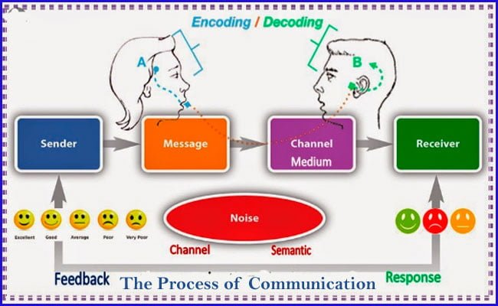
Communication
A purposeful process of exchanging information
An act of transferring thoughts
and meanings between senders and receivers
A meaningful exchange that benefits both parties
Providing data, information, insights, etc.
Involves written, oral, visual, or electronic media
A continuous system carried out with the aim of achieving desired goals

Slide 13
Technical Communication
Practical business communication
Oral and written communication for and about business and industry
Basically used in the work environment by the professionals
Focus on goods and services (e.g. how to produce, market, manage, etc.)
Used to communicate technical and scientific information
Examples: Conversing to customers, writing a letter, making a PowerPoint presentation, writing reports, marketing and seeking job.

Slide 14
Why Does Effective Technical Communication Matter?
For maintaining a closer relationship with important market communities
To make conversations and perceptions effective(to enable your readers to understand a highly complex process or concept clearly)
For increasing productivity/better financial performance
For making marketing messages more persuasive
For solving problems at pace
For enhancing employee satisfaction

Slide 15
Communication Process or Model
Communication is a well-defined and systematic information sharing process
Following the process approach will help to communicate effectively
It will assist to set up commonality between the participants
Sender and receiver are the two inseparable entities (reverse the roles)
Who (Sender/source) Encoding: Done by the source; converting message into understandable language
Says what (Message) Decoding: To understand the meaning in one’s own language
To whom (receiver/audience)
In which channel (medium)
With what effect (impact/feedback)
What are the disturbances (semantic: meaning-related; technological: channel related; and environmental: factors of environment like strong wind, vehicles, etc.)

Slide 16
Major Steps in Technical Writing
Prewriting (Thinking about Aim and Audience): Determine goals (to persuade, instruct, inform, educate or build rapport?), consider audience, gather data, examine purposes, determine communication channel; use various prewriting techniques like brainstorming, creating organizational charts, flowcharting and researching
Writing (Organization and layout of information, the use of headings and numberings): By organizing materials, considering layout and design of the communication, adding visual aids)
Rewriting: Rewrite your writing by adding, deleting, simplifying, reformatting and correcting; Proofread and apply the checklist

Slide 17


